Slide 1
GRAMMER DETECTION FROM GIVEN TEXT OR MESSAGE
GROUP MEMBERS:
AMAN KUMAR (18CSE134)
ASHUTOSH ANAND (18CSE122)
KESHISH KUMAR (18CSE133)

Slide 2
INDEX
1.INTRODUCTION
2.SCOPE
3.SYSTEM ANALYSIS
4.Operating Environment
5.System Design and Specification
6.Zero level and One Level DFD
7.Coding and Output
8.Colclusion and Limitation

Slide 3
INTRODUCTION :
PURPOSE
* The present Grammar Detection Software Requirements Specification (SRS) document was prepared as the next incremental step after the grammar detection Scoping and Requirements (S&R) document,
* The present document is described how to design and what are the things to require for the development of the Grammar Detection. The SRS captures and describes the desired behaviour of the end product in a wide range of situations. Some of the non-functional requirements in this document were taken as is from the scoping document and can still be refined.

Slide 4
PROJECT SCOPE
As described in the Grammar Detection (S&R) document, the Grammar detection is a tool to, regional or thematic level, including the possibility to offer access to additional sources of information. The primary users of this software is developer and then uses in public it uses in manly two level first developer and public this application find your mistake in sentences.

Slide 5
SYSTEM ANALYSIS:
User Accounts:
User accounts are password protected (Utilization of In Common Federation will considered in future phases of requirement) Password reminders and resets are handled by the website.
System Security:
Public has read-only access via website (he can’t change my website document).

Slide 6
Recover Data
User can recover its login detail and he can change the password user name.
Portable
It can apply in many websites as you want.
Security Requirements
The system shall retain an audit log for all successful operations.

Slide 7
Operating Environment
The system shall operate with the two latest major releases of the following Web browsers: Firefox, Opera, Chrome, Internet Explorer etc. The system shall operate on a server running Linux, Windows server or Mac OS.
Working project in Google Collab that open source

Slide 8
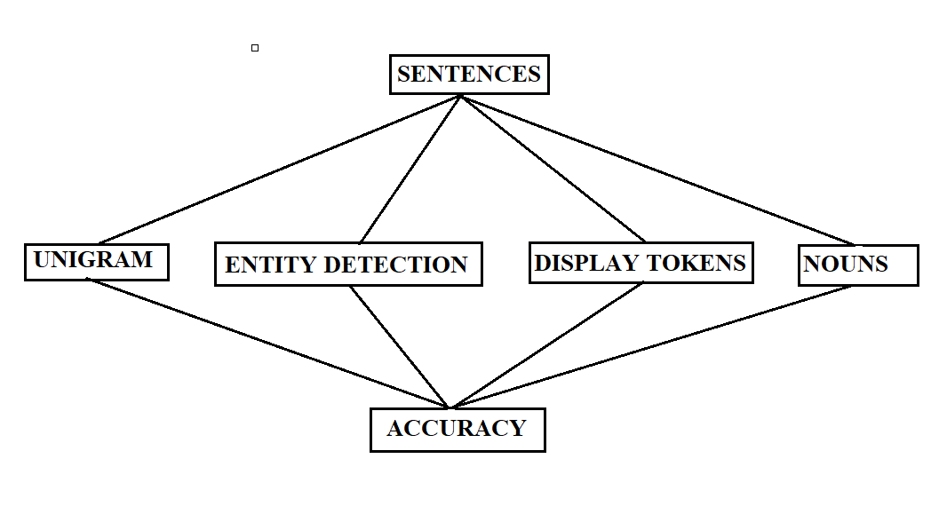
SYSTEM DESIGN AND SPECIFICATIONS :
STRUCTURE CHART

Slide 9
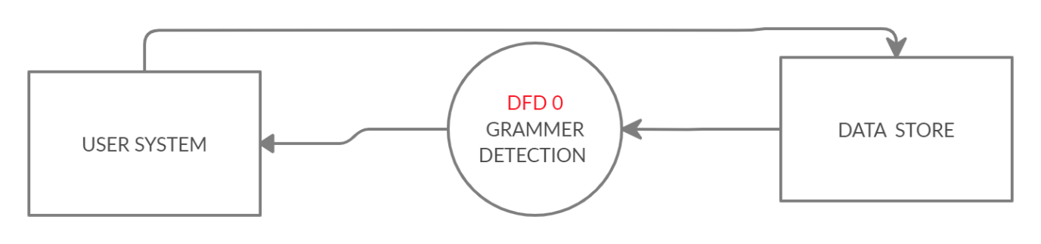
DFD
ZERO LEVEL DFD

Slide 10
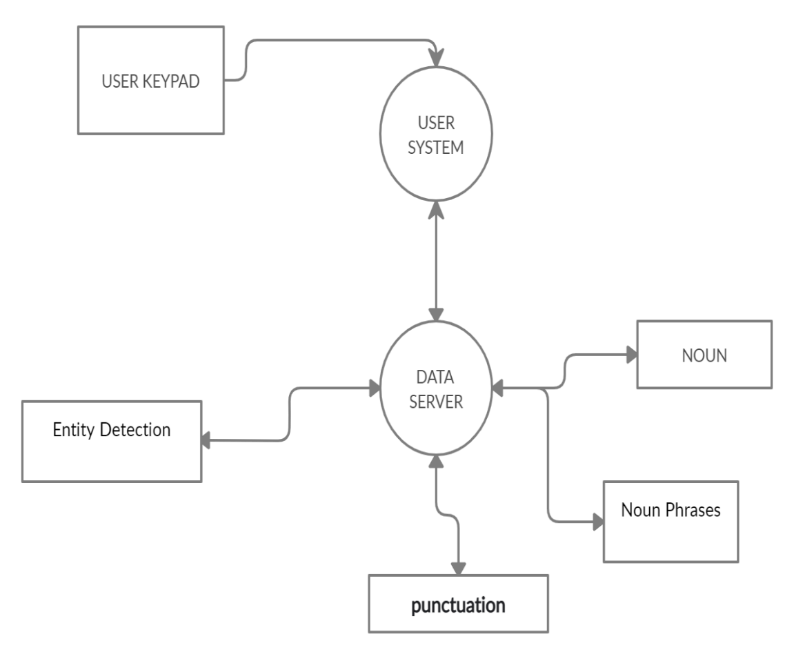
ONE LEVEL DFD

Slide 11
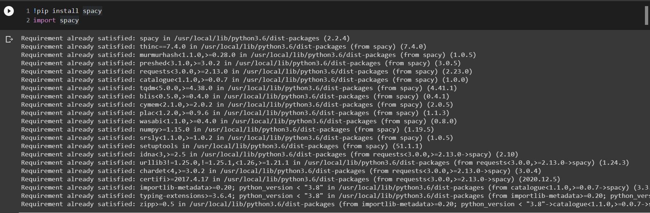
CODING WITH OUTPUT:

Slide 12
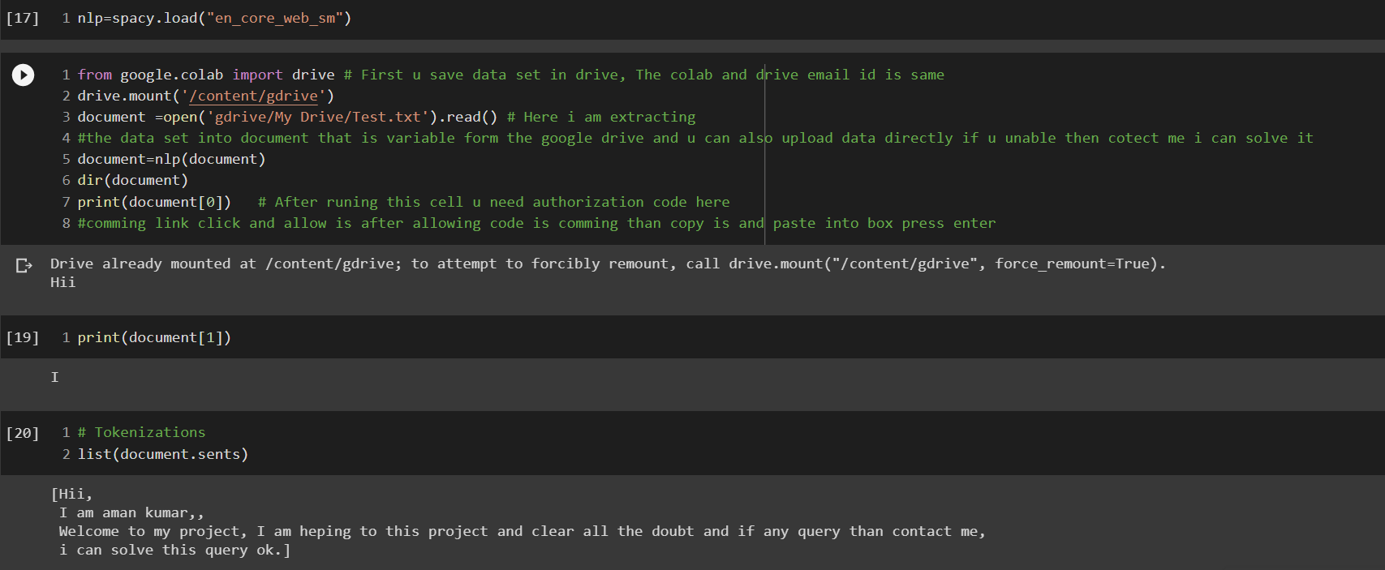

Slide 13
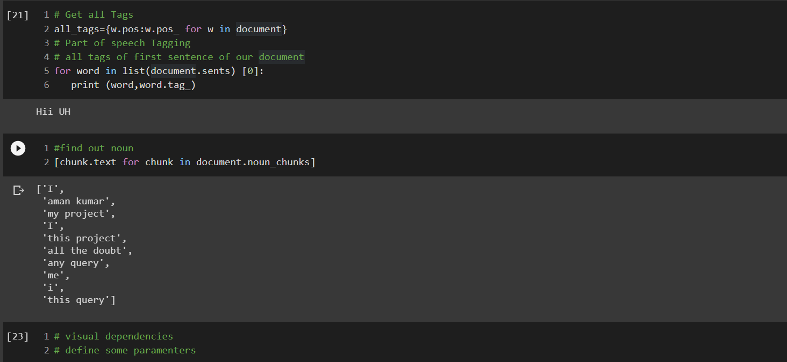

Slide 14
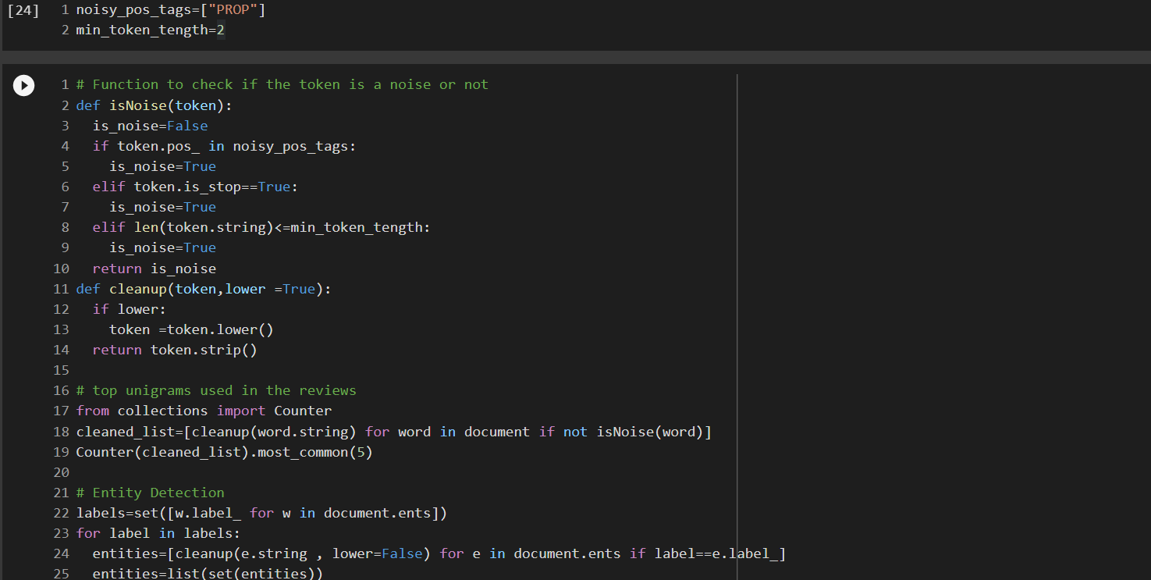

Slide 15
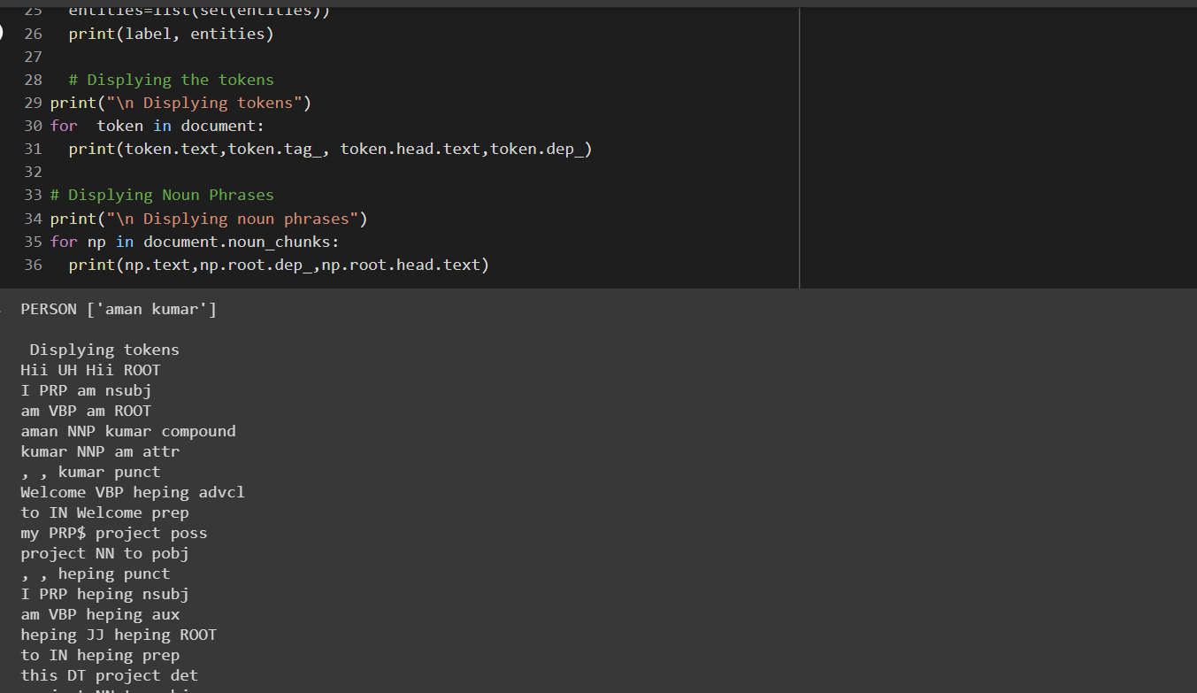

Slide 16
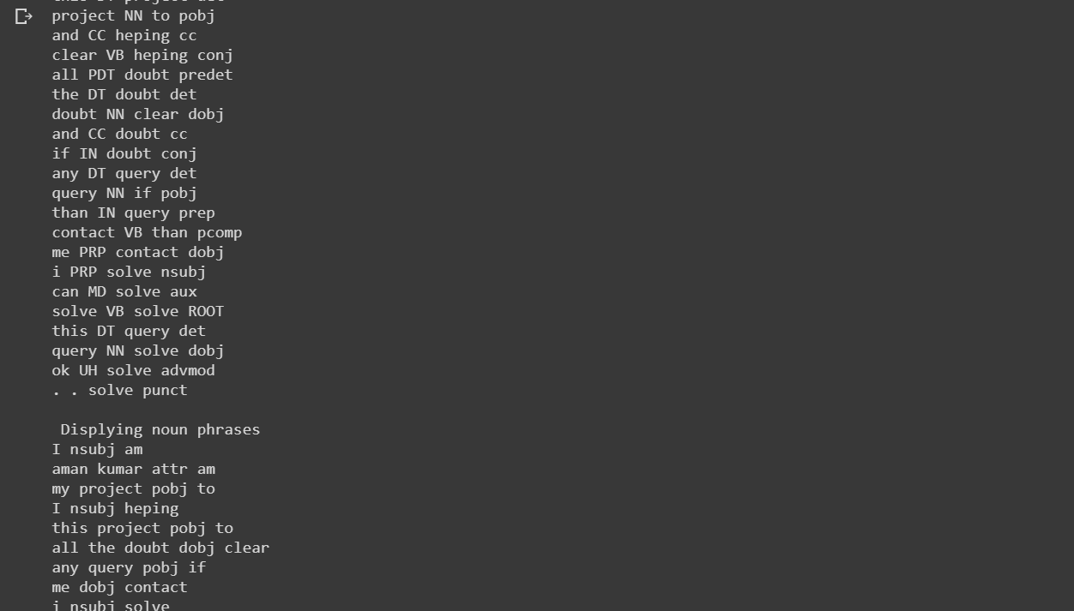

Slide 17
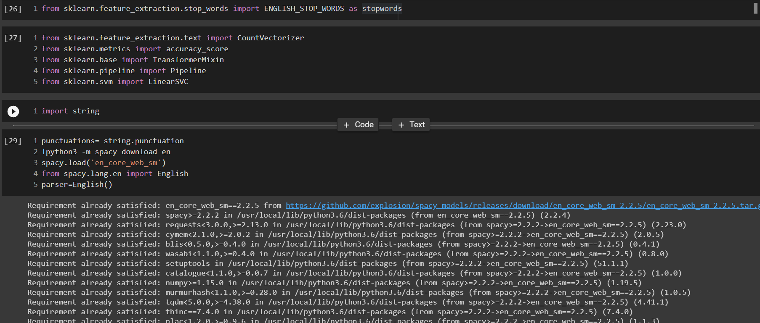

Slide 18
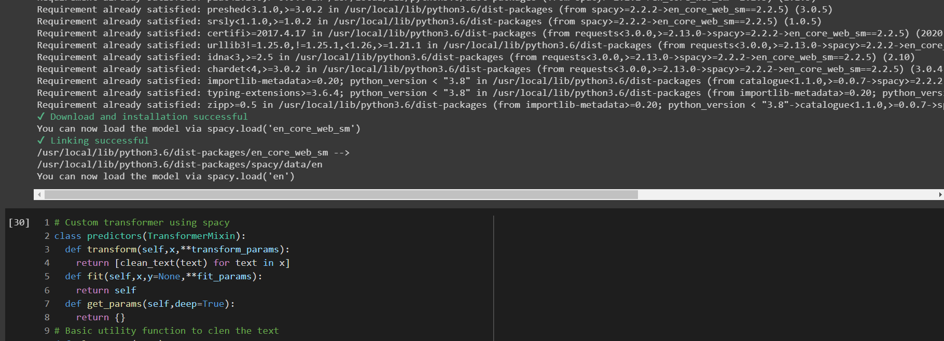

Slide 19
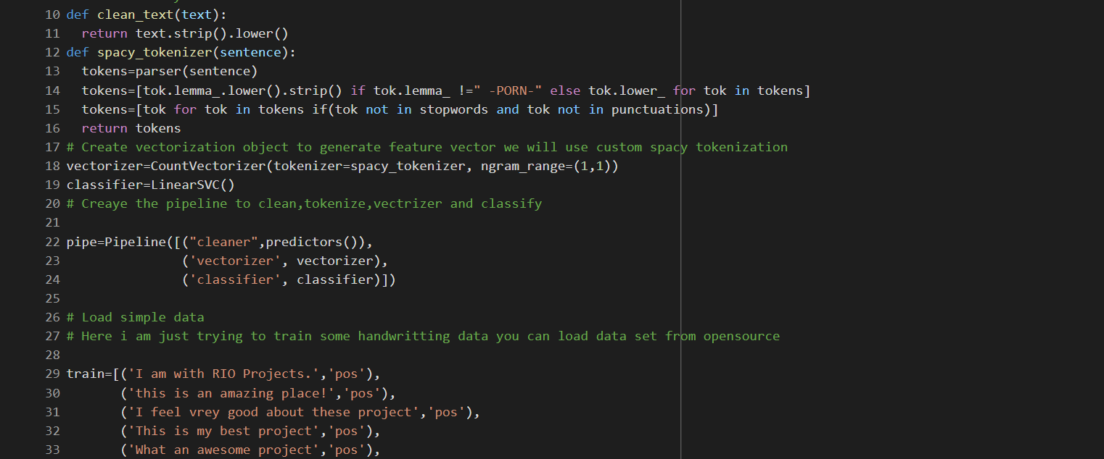

Slide 20
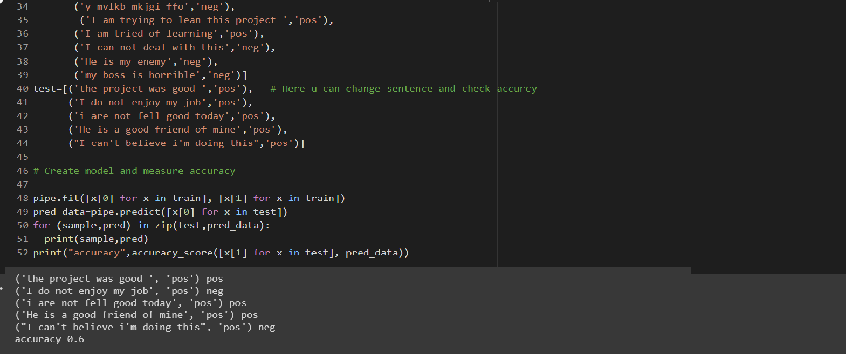

Slide 21
CONCLUSION & LIMITATION
The conclusion to this project is basically focus on accuracy of your sentences. It work on given training data set and predict the sentence is negative or positive based on your preferred option. After training the data set you need to test them and find accuracy.
Limitation of this project is you cannot apply in online mode it is not available in publicly and other persons can not access of this project without permission.
It is platform dependent now.

Slide 22
RUNABLE FILE
LINK OF RUNABLE FILE:GitHub - Aman1500163/Project-Report-of-V_sem
Notes:
LINK OF RUNABLE FILE:GitHub - Aman1500163/Project-Report-of-V_sem

Slide 23
THANK YOU

